Slide 1


MCA MAJOR PROJECT · KIET GROUP OF INSTITUTIONS
CodeCraft
AI Powered Interview Preparation Platform
Divyam Raj ( 202410116100066)
Divakar Verma ( 202410116100065 )
Divyanshu Mishra ( 202410116100068 )
Guided By: Ms. Annu Yadav

Slide 2

INTRODUCTION
Why AI-Driven Interview Preparation?
Interview preparation is a critical determinant of career success, yet traditional methods remain fragmented, slow, and impersonal. Candidates lack access to intelligent, adaptive feedback systems that can evaluate their responses in real time.
Static Resources
No Instant Feedback
Mentor Gap
Fixed question banks with no adaptability to individual skill levels.
Delayed or absent evaluation prevents meaningful improvement.
Limited access to expert guidance creates preparation bottlenecks.

Slide 3

PROBLEM STATEMENT
Challenges in Traditional Preparation Systems
📦 Static Question Banks
⏳ Delayed Feedback
Pre-defined questions with no dynamic generation or difficulty adaptation.
No instant or automated evaluation of candidate responses.
👤 No Personalisation
📊 No Progress Tracking
Generic guidance that ignores individual strengths and weaknesses.
Absence of long-term performance analytics and session history.
These gaps directly reduce candidate readiness and confidence in competitive technical interviews.

Slide 4
OBJECTIVES & COMPARISON
Project Objectives & System Comparison
Core Objectives
Existing System vs CodeCraft
Intelligent AI-driven question generation
Feature
Existing System
CodeCraft
Questions
Static, fixed
AI-generated, dynamic
Real-time answer evaluation via Gemini API
Feedback
Generic / delayed
Real-time, personalised
Personalised, structured feedback delivery
Dependency
Human mentor
Automated AI engine
Secure authentication & session history tracking
Analytics
None
Full performance dashboard
Responsive, modern cross-device interface
Accessibility
Limited
24/7, cloud-based

Slide 5
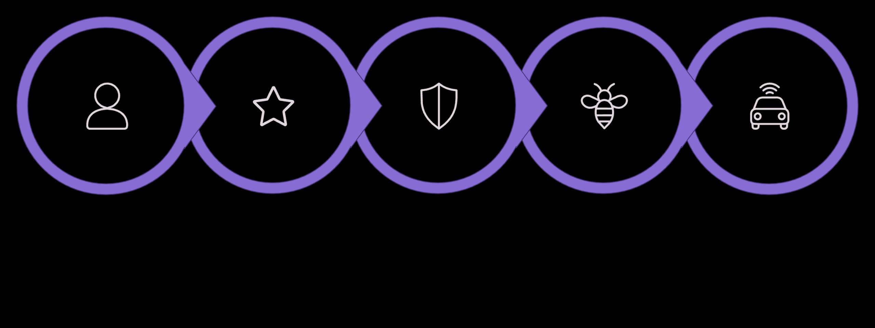
ARCHITECTURE & STACK
System Architecture & Technology Stack
User
Next.js Frontend
Clerk Auth
Next.js API
Gemini AI
End-to-end flow from user interaction through secure authentication, AI processing, persistent storage, and performance visualisation.
Frontend
Backend
Next.js · React · Tailwind CSS · ShadCN UI
Node.js · Next.js API Routes
Auth & DB
AI & Deploy
Clerk · MongoDB + Mongoose
Gemini API · Vercel

Slide 6
KEY FEATURES
What CodeCraft Offers
AI Evaluation Engine
Dynamic Questions
Gemini-powered real-time assessment of coding and theoretical answers with structured scoring.
AI generates unique, category-specific questions tailored to difficulty and topic.
Coding Practice Interface
AI Chatbot Support
In-browser code editor with syntax highlighting and instant AI feedback on submissions.
Conversational assistant for doubt resolution, hints, and interview guidance.
Session History
Responsive Dashboard
Complete interview session logs with retrievable past performance records.
Analytics-rich, fully responsive UI accessible across all devices and screen sizes.

Slide 7
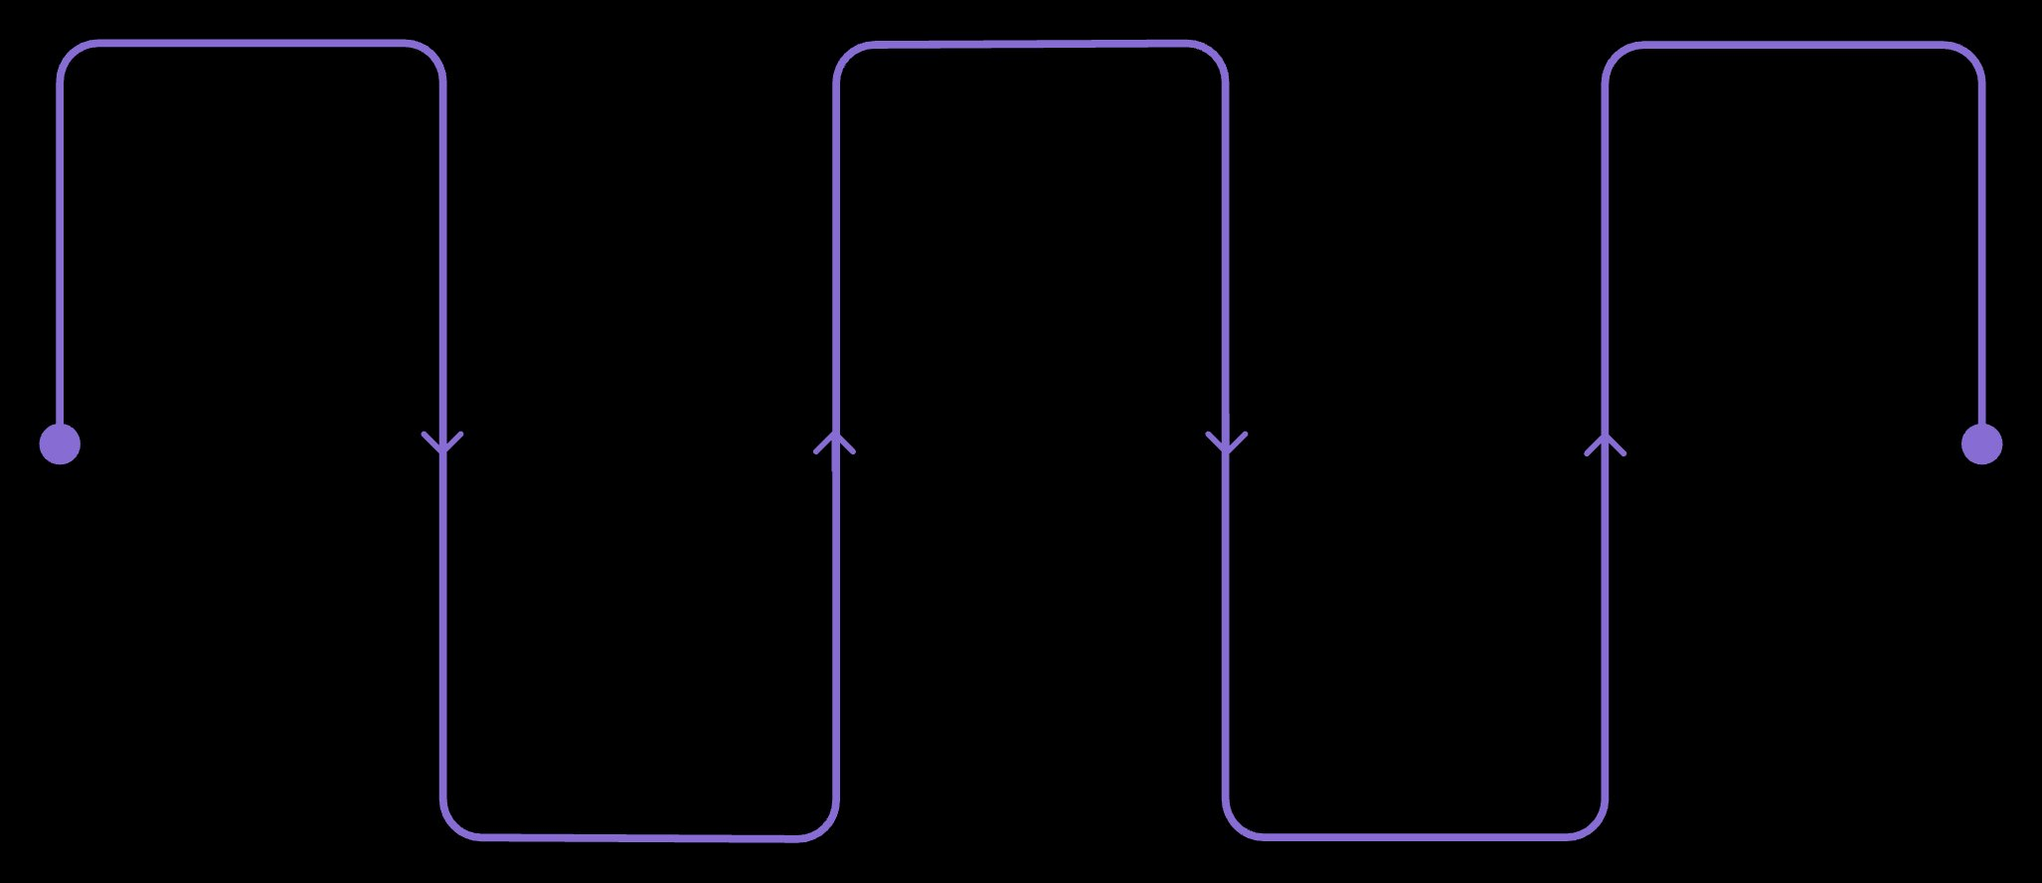
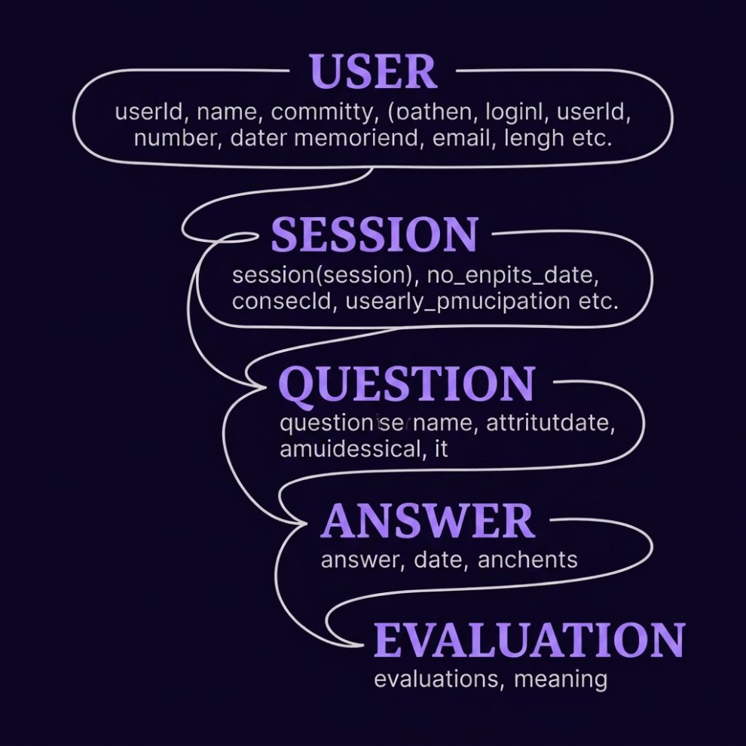

WORKFLOW & DATABASE
Application Workflow & Data Model
User Login
Generate Question
AI Evaluation
Authenticate and start session
Automated scoring and notes
Produce prompt via AI
Database Schema (MongoDB)
Select Category
Submit Answer
Choose topic and difficulty
User submits response
Seamless end-to-end interview session flow from authentication through AI evaluation to persistent performance review.
Five core entities with relational mappings ensure complete traceability from user authentication through to AI-generated evaluation records.

Slide 8

AI INTEGRATION & TESTING
Gemini AI Integration & Quality Assurance
AI Integration Pipeline
Testing & Validation
01
Test Type
Scope
Status
Prompt Construction
Unit Testing
API routes, utils
✅ Passed
Context-rich prompts built from user answer, category, and difficulty.
Integration
Auth → DB → AI
✅ Passed
02
Functional
End-to-end flows
✅ Passed
Gemini API Call
Security
Auth, input sanitisation
✅ Passed
Structured request dispatched to Google Gemini Pro for evaluation.
UAT
Real user scenarios
✅ Passed
03
Response Parsing
AI output parsed into score, strengths, and improvement areas.
All test suites completed with zero critical defects.
04
Feedback Delivery
Formatted, actionable feedback rendered instantly to the user.

Slide 9
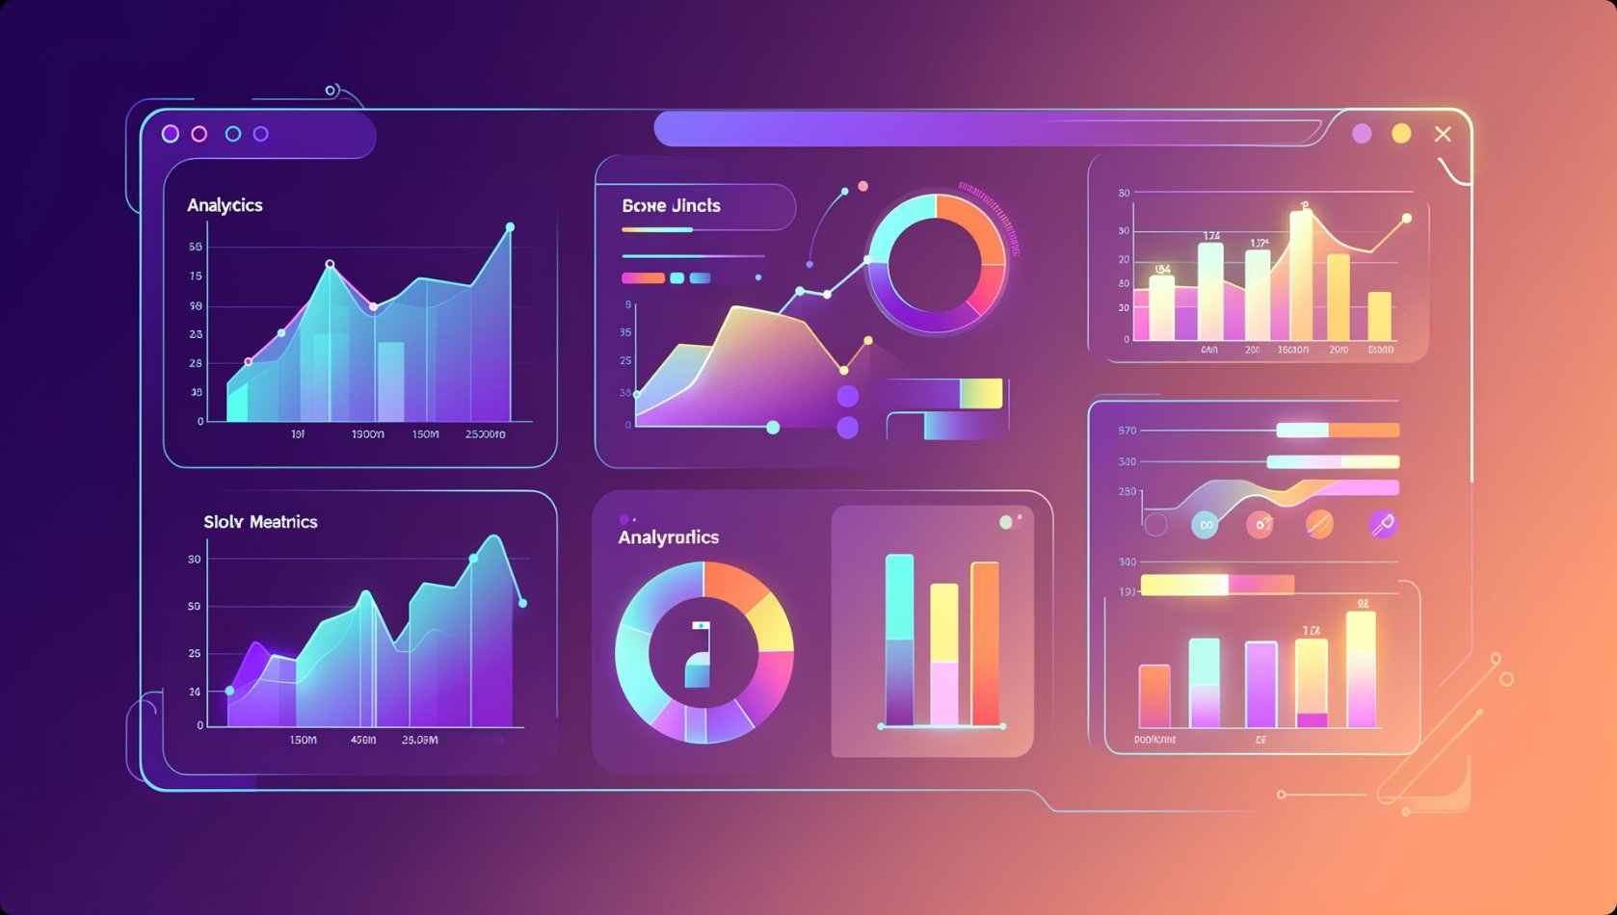
RESULTS & ADVANTAGES
Project Outcomes & System Advantages
~1.2s
99.8%
AI Response Time
Auth Reliability
Average evaluation latency per answer submission.
Successful session handling via Clerk authentication.
100%
5
Objectives Met
Test Categories
All six project objectives successfully achieved.
Comprehensive testing across all validation layers.
Key Advantages
Personalised Learning — Adaptive feedback tailored to individual performance patterns.
24/7 Availability — No dependency on human mentors; always accessible.
Cost Effective — Eliminates expensive coaching and consultation fees.
Scalable Architecture — Cloud-native design supports growing user bases effortlessly.

Slide 10
FUTURE SCOPE & CONCLUSION
Future Roadmap & Conclusion
Future Enhancements
Conclusion
Voice Interviews
1
CodeCraft successfully delivers a fully functional, AI-driven interview preparation platform meeting all project objectives. The system demonstrates a scalable, secure architecture with real-time intelligent evaluation, personalised feedback, and a modern user experience — positioning it as a future-ready solution for technical interview readiness.
Speech-to-text AI evaluation for verbal mock interviews.
2
Video Analysis
Behavioural and confidence assessment via webcam integration.
Resume Evaluation
3
Thank You — We welcome your questions and feedback.
AI-powered resume scoring and ATS compatibility checks.
Divyam Raj · Divakar Verma · Divyanshu Mishra | Guided by Ms. Annu Yadav | KIET Group of Institutions
4
Company Patterns
Interview question banks tailored to specific organisations.
AI Coding Interviewer
5
Live problem-solving sessions with adaptive difficulty.

